Slide 1

HANDWRITTEN DIGITS CLASSIFICATION /RECOGNITION
Presented by:
KV Pradeep

Slide 2
PROBLEM STATEMENT
As we know as every person has different style of writing digits, humans can recognize easily but for computers it is comparatively a difficult task so here we have used neural network approach where the machine will learn on itself by gaining experiences and the accuracy will increase based upon experience it gains.
Handwritten digit recognition system is working of a machine to train itself so that it can recognize digits from digits from different sources.
Errors in Digit recognition cause severe problems like digits written on a bank cheque if recognized erroneously could result in unfortunate consequences.
The goal of our work is to create a model that will be able to recognize and classify the handwritten digits from images.
We apply the Handwriting digit classification by working on MNIST Dataset.

Slide 3
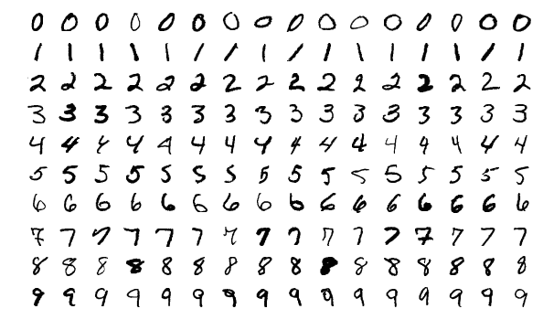
DATASET
MNIST set is a large collection of handwritten digits.It is a very popular dataset in the field of image processing.
MNIST is short for Modified National Institute of Standard and Technology database.
MNIST contains a collection of collection of 70000 handwritten images .Each image of 28x28 pixels i.e.about 784 features.Each feature represents only one pixel’s intensity i.e.from 0(white) to 255(black).
This database is further divided into 60,000 training images and 10,000 images.
The label of each image is the intended digit of the handwritten image between 0 and 9.
A sample of dataset is given below.

Slide 4
OUTLINE:
CONVOLUTION NEURAL NETWORK
METHODOLOGY
TRAINING OF MODEL.
RESULT
CONCLUSION

Slide 5
CONVOLUTION NEURAL NETWORK
Convolution Neural Network is a deep learning method which is broadly used for image classification,image recognition ,object detection etc.,
In this project , we will see how CNN’s can be used for image classification.For this , the model takes an image as input ,processes it and classifies it under a certain category.An image is collection of pixels,with features which specifies the height ,width and the dimensions of the image.
For example- image with 6x6x3 dimensions signifies that it is an RGB(Red,Green,Blue) color image while an image with dimensions 6x6x1 signifies a grayscale images.

Slide 6
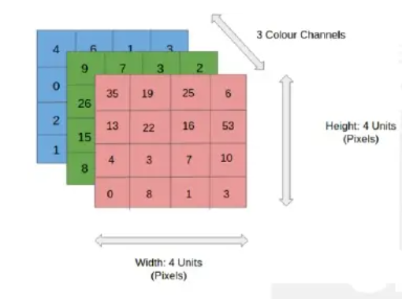
CONVOLUTION NEURAL NETWORK
In the figure,we have 4x4x3 RGB image which has been separated by its three color panels- RED,GREEN and BLUE.The height and width of image is 4. In grayscale image ,the color channels will be reduced to 1.
There are a number of such color spaces for images such as Greyscale, RGB, HSV , CMYK etc,
In the CNN model , the training and testing of the input image is performed by passing the image through a series of convolution layers with filters.These filters are also known as kernels.
This is followed by the pooling layers for feature extraction ,the dense layers and finally ‘softmax’ function is used for classifying the object within a probabilistic range of values of 0 to 1.

Slide 7
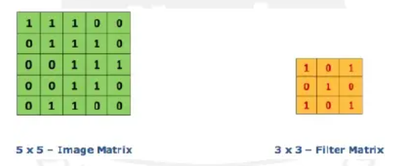
CONVOLUTION NEURAL NETWORK
Convolution layer
The convolution layer is first layer of CNN model architecture which starts to extract features from the input.The convolution layer operates with two inputs, One is the image matrix while the other being the filter or kernel.
The convolution layer safeguards the relationship between the original image pixels by learning the features of the image using small square patches.
In the figure, we have an image matrix of size 5x5 and a kernel size of 3x3.The image values are 0 and 1. Therefore to obtain a ‘Feature map’ we multiply the image matrix with the filter.

Slide 8
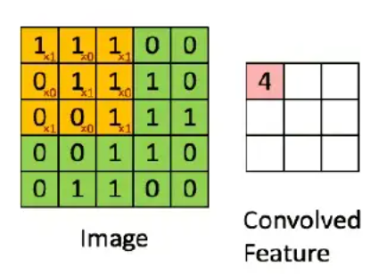
CONVOLUTION NEURAL NETWORK
In the image, We can see how feature map is extracted ,The green 5x5x1 matrix represents the original input image while the yellow moving patch is the filter or the kernel.
After the multiplication ,we get a value of 4 in the first slot of feature map.This process continues.
PADDING AND STRIDES
Padding and strides have an impact on how the convolution procedure is carried out.
Padding and can be used to increase or decrease the dimensions(height and width) of input/output vectors.
Padding is a term used in convolution neural network to describe how many pixels are added to an image when it is processed by CNN kernel.if the padding in a CNN is set t

Slide 9
CONVOLUTION NEURAL NETWORK
POOLING LAYER
Pooling layer is another extremely significant feature of convolution neural networks.Pooling layer will resolve to reducing the number of parameters when the image are large.
Pooling is also known as subsampling or down sampling which helps us to reduce the dimensionality of each feature map by focusing on the most important aspects of the information obtained.
FULLY CONNECTED LAYER
Every CNN architecture is provided with a fully connected layer of neurons at the end.
As in CNN, neurons in a fully connected layer have fill connections to all activations in the previous layer and work similarly.
After training , the feature vector from fully connected layer is used to classify images into distinct categories.
Every activation unit in the next layer is coupled to all inputs from this layer.

Slide 10

METHODOLOGY
At first, we have imported all the necessary modules that we require to build the model.Keras provides us with predefined datasets, among which,the most important part is to import dataset which we have used in our model i.e., the ‘MNIST’ dataset of the handwritten digits.
Load the MNIST dataset using keras.
After loading the MNIST data,Segregate the imported dataset into Training and Testing data for evaluation.

Slide 11
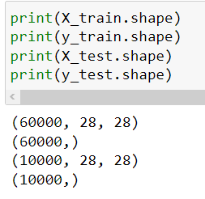
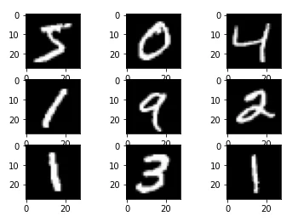
METHODOLOGY
The shape of Training and Testing dataset is given below.
Shown below is first 9 images of the training dataset which will in grey scale.
Next,we need to make sure that we shape our input datasets so that there is complete uniformity before training of model . We have already set the number of images in the training set to 60000 and to test set to 10000.

Slide 12

METHODOLOGY
One Hot coding/Normalization - The next task is to convert the input data into categorical format so that it is easier to classify the digits.The final layer(dense layer) of CNN model consists of 10 nodes, one for each of digits ranging from 0 to 9. When a model is fed with an image,it ranges the probability of digits according to the nodes.
The predicted output which we will be returned to the user in the node which will have highest probability.for example- if the first node has the highest probability then the output will be ‘0’,similarly if the last node has the highest probability then the output will be ‘1’.
For the labels of one-hot encoding ,since we have a total of ten possible outputs,the model will allot ‘1’ for the node with highest probability and the rest as ‘0’.For example-if we have a predicted output of 3 then the labels after one hot encoding will produce the output as [0,0,0,1,0,0,0,0,0,0]
We should resize the images by increasing one dimensions for kernel operations. We can also see the dimension of each image as 28x28x1 which signifies that the images are square with same height and width and the 1 specifies that they are grayscale images.

Slide 13
METHODOLOGY
The Keras model type which we have used to build the model is ‘Sequential’.It helps to build model,one layer after the other,by using the add() function for adding the layers one by one.’Sequential’ can be imported by using,
Then we compile the models together using the parameters ‘optimizer’ set to ‘ADAM’ as it is very good optimizer to use for many cases.it adjusts the learning rate throughout the training.
We will use ‘Sparse_Categorical_Crossentropy’ for our loss function because it saves time in memory as well as computation since it simply uses a single integer for a class,rather than whole vector.
In order to determine the accuracy,we will use the ‘accuracy’ metric to see the accuracy score on the validation set when we train the model.

Slide 14
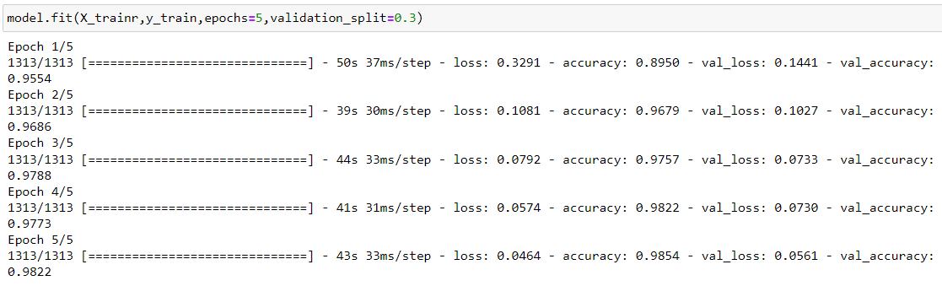
TRAINING OF MODEL
The model will be trained on X_train ,y_train dataframes and will be validated on X_test and y_test dataframe.After multiple experiment on the model,the optimum number of epochs was found to be 5 which has been specified
The model will be validated on X_test and y_test dataframe.

Slide 15
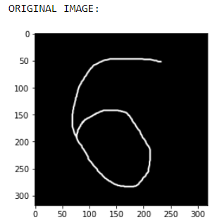
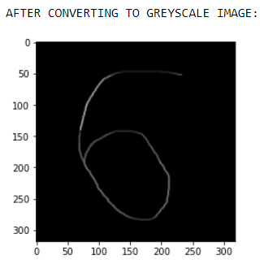
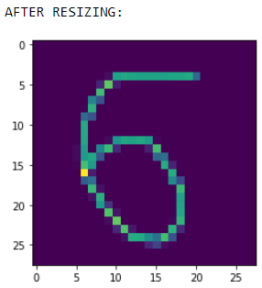
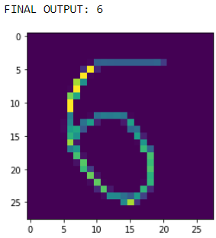

RESULT
The final validation accuracy which we have gained is 0.98000 i.e.,98% .Now we will predict the images and see how well our model is performing.
We take single handwritten digits to check how well our model is performing.The image is hand drawn on Microsoft Paint and saved in PNG format.The image is of a ‘six’ number.
‘Softmax’ probability values of the image, where we can see corresponding probability value of ‘6’ is the maximum

Slide 16
CONCLUSION
This project represents the technique used for recognize the handwriting digits .
This project also focuses on that in today’s world handwriting reorganization is very difficult but very important.
There are many applications where we need handwriting recognition system like bank cheques and form documents.
They are also used to decode audio,text and video.if the task at hand is to find a pattern in a series,convolution neural networks are an excellent choice.

Slide 17
THANK
YOU

